Slide 1
Meeting Week 16
Last week summary
Parameter recovery
Multisine design
Outline ToDo next week

Slide 2
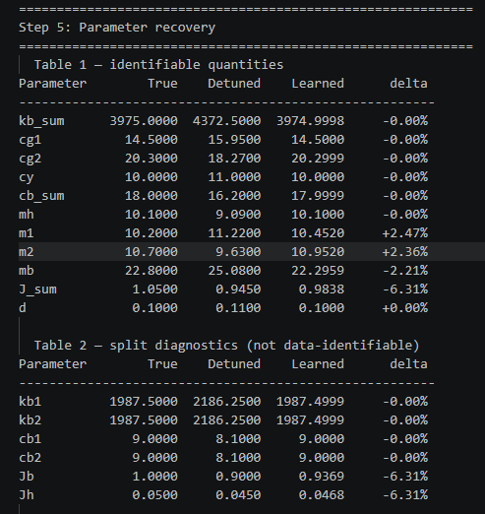
Last week summary
Periodic Schroeder multisine
  Added 40% of max hardware limit → needed to reduce this
Parameter recovery
  4 parameters where not currently identifiable

Slide 3
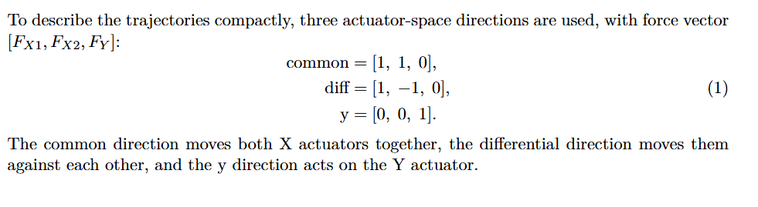
Frequency range multisine
Previously frequency range chosen by:
  which injected-force frequencies survive the closed-loop feedback
  which surviving frequencies produce measurable plant motion
Instead need to design for the system:
  Need to consider multiple Y-positions
  Do multiple tests for different modes
  FRF

Slide 4
Trajectories
The different modes concept is taken from Garciá

Slide 5
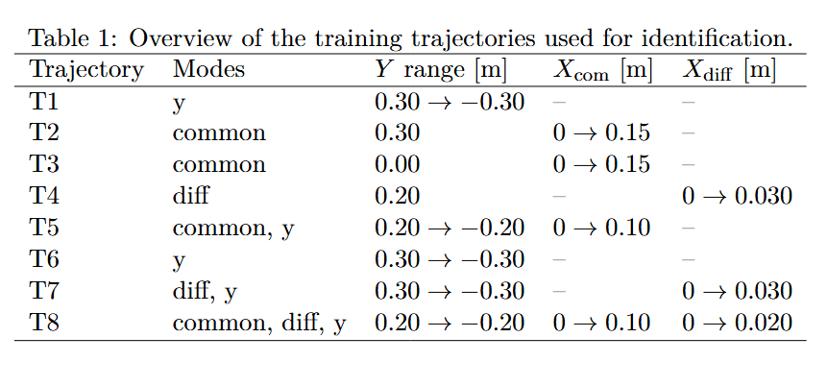
Trajectories
Note: T8, X moves in the same direction, but also creates an offset

Slide 6
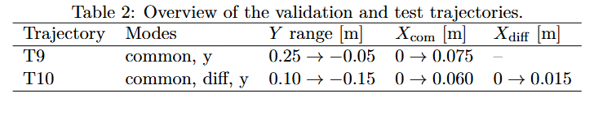
Trajectories

Slide 7
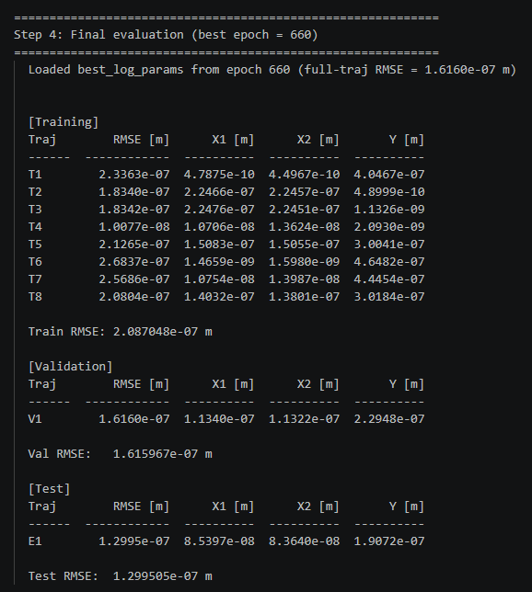
Trajectory – parameter recovery
Out of 1500 epochs, best validation RMSE for epoch 660

Slide 8
Trajectory – parameter recovery
Mainly J_sum
m1, m2 and mb

Slide 9
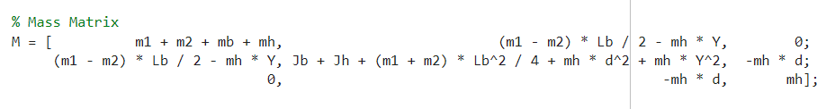

Trajectory – parameter recovery
Feedback Quinten:
  The matrix indexes are properly identified.
  If we sum each matrix index all the parameters we match the true parameters
    But current problem the individual parameters

Slide 10
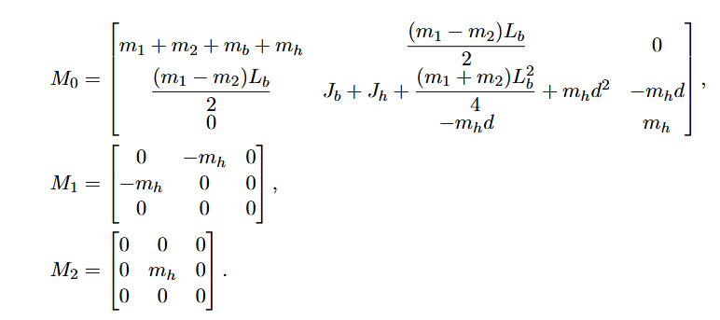
Print additional table for each matrix index

Slide 11
Slide 1
  Need to design around the system, what preferred high or low frequencies…?
Slide 2
  Show trajectories
  New plot with trajectories + multisine
    But first explain the new multisine amplification, justify with literature?? Needs to survive in given bandwidth preferable maximum amplitude, but relative to trajectory not 40% max hardware limit BAD DESIGN !.
Slide 3
  Not affecting the gradient only different reconstruction matrix indici
Slide 4
  Notch step something like that for slowest dynamic
  And resampling
General note: show plots

Slide 12
Design around system
Previously for multisine frequency range fslow and fshigh
  Determined from what survives
Instead: look at the system
  Do by FRF → bode plot …

Slide 13
RMS force ratio
rho_rms_j = rms(f_ms_j) / rms(u_traj_only_j)
This answers: how much extra broadband force power are we adding relative to the nominal experiment?
Peak force ratio
rho_peak_j = max(abs(f_ms_j)) / max(abs(u_traj_only_j))
This catches crest-factor problems.
Total-force increase
rho_total_j = rms(u_total_j) / rms(u_traj_only_j)
This answers: how much more demanding did the experiment become after injection?
Trajectory distortion ratio
rho_track_j = rms(q_ms_j - q_nom_j) / rms(q_nom_j - mean(q_nom_j))
or relative to the commanded motion amplitude.

Slide 14
Multisine
Took conservative range for now 1-100 hz
B(rho) = rms(q_ms - q_nom, projected onto mode) minimum rho that satisfies this (heuristic)
  B_min = 1e-5 m
    Determined based on trajectories that only excite one mode
- q_ms — position trajectory [X1, X2, Y] (N×3) from the simulation with multisine injected
- q_nom — position trajectory [X1, X2, Y] (N×3) from the trajectory-only simulation (no multisine)
- q_ms - q_nom — the pure position perturbation caused by the multisine (N×3)
- md.f_vec — the modal direction vector, e.g. [1, 1, 0] for common mode. Used here as a projection: (q_ms -
q_nom) * [1,1,0]' gives a scalar signal = X1_diff + X2_diff, projecting the 3-axis perturbation onto the
active mode direction
- rms(...) — RMS of that scalar perturbation signal over time
- B_sweep(i, r_idx) — the result: how much the multisine moves the system in the active modal direction, for
trajectory i at rho candidate r_idx

Slide 15
Plots multisine
Row 1 - Position overlay
The commanded trajectory position vs the actual simulated position, with and without multisine.
Row 2 - Position perturbation
The difference q_ms - q_nom. Isolates exactly what the multisine adds to the position. For inactive channels
Row 3 – Additional Force
Input force to the plant
Row 4 - Force spectrum
The frequency content of the actuator force in the active modal channel, before and after multisine injection.
Notes:
Took conservative range for now 1-100 hz

Slide 16
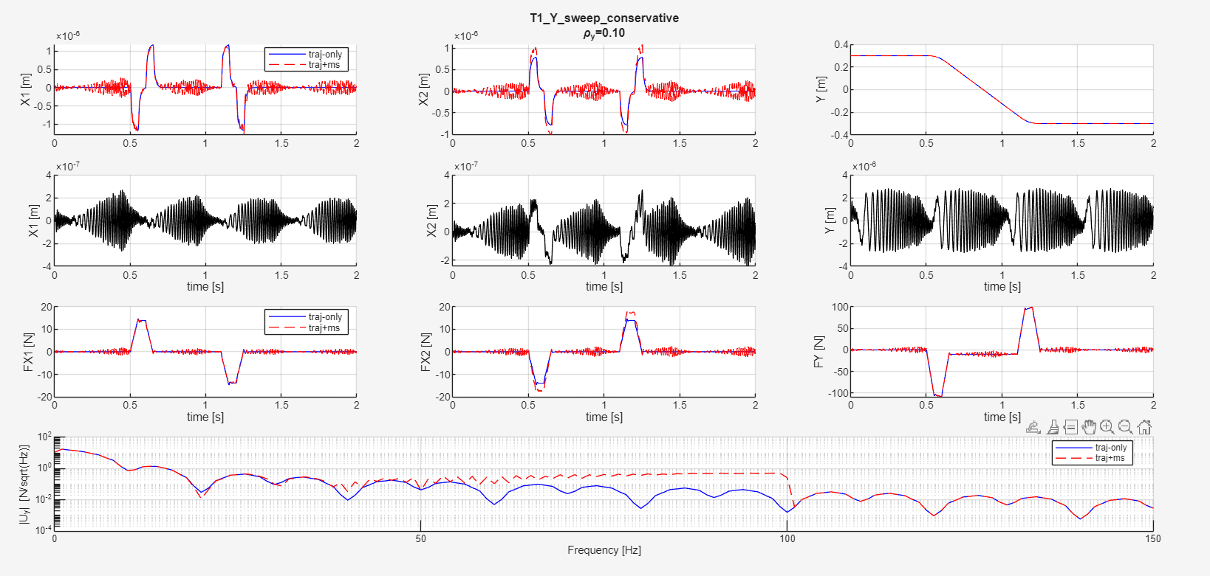
Notes:
Mismatch m1 m2
Controller for the difference
Multisine only on Y here, because for that mode we are looking

Slide 17
Yes, that's a reasonable simplification. Let me work out what the system
actually gives you.
Yaw resonance from M(Y)(2,2):
M(Y)(2,2) = Jb + Jh + (m1+m2)·Lb²/4 + mh·d² + mh·Y²
= 1.0 + 0.05 + 20.9·(0.725²)/4 + 10.1·(0.1²) + 10.1·Y²
≈ 3.90 + 10.1·Y²
At Y=0: f_res ≈ (1/2π)·√(3975/3.90) ≈ 5.1 Hz
At Y=±0.35: f_res ≈ (1/2π)·√(3975/5.13) ≈ 4.4 Hz
So the yaw resonance sits around 4–5 Hz and barely moves with Y (the
mh·Y² term adds at most ~30% to the inertia). The variation is small.
The other dynamics: The X and Y translations have no stiffness, so no
resonance there — just mass-dominated rolloff. The only resonance in the
whole system is this one.
What the bandwidth gives you: The controller is designed at fbw = 100 Hz.
Below ~100 Hz the controller shapes the closed-loop; above that the
plant rolls off at -40 dB/dec (double integrator for the rigid modes).
The identifiable content — where the FP model's M(Y) approximation
actually matters for augmentation — lives below a few hundred Hz.

Slide 18
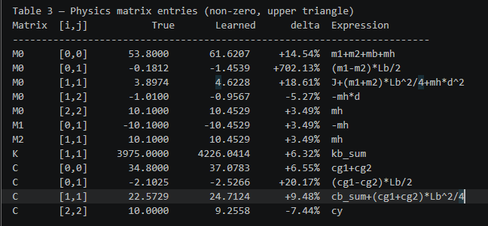
Parameter recovery
Multisine

Slide 19
Outline next week
Parameter recovery without multisine is able to match the system
  Need to determine what to do with non-identifiable parameters
Multisine design
  What is causing the issue for identifiability
  Feedback Maarten not Schroeder but random multisines generate choose with low crest factor
Resampling
  → Determine highest frequency in the system

